Slide 1
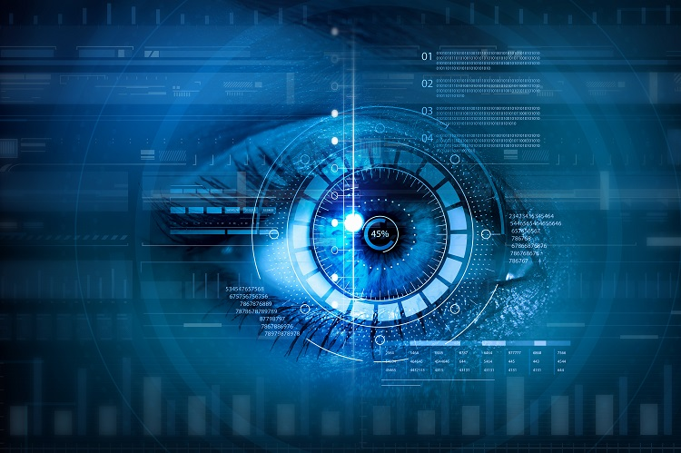
Guided by:
Dr. T. K. Senthil Kumar
Submitted by:
Mohamed Idris Maricar
190114011
Hussain Baqir Challawala
190114013
Facial Recognition: IDENTIFY PREMIUM CUSTOMERS

Slide 2
Objectives & Goals
OUTCOME
EXPERIMENT, WORK DONE
RESULTS
METHODOLOGY & TECHNOLOGY
DATA ANALYSIS

Slide 3
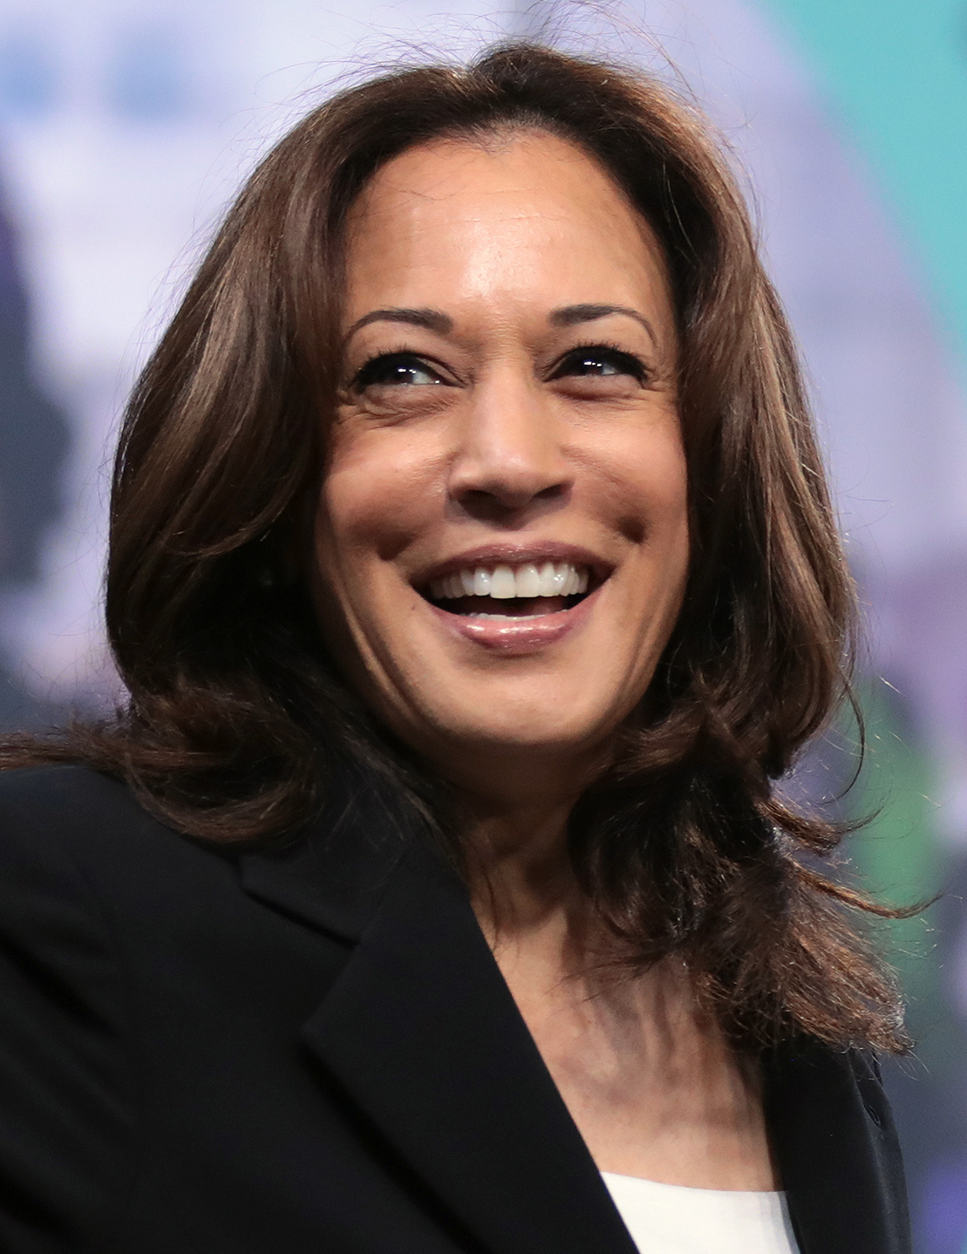
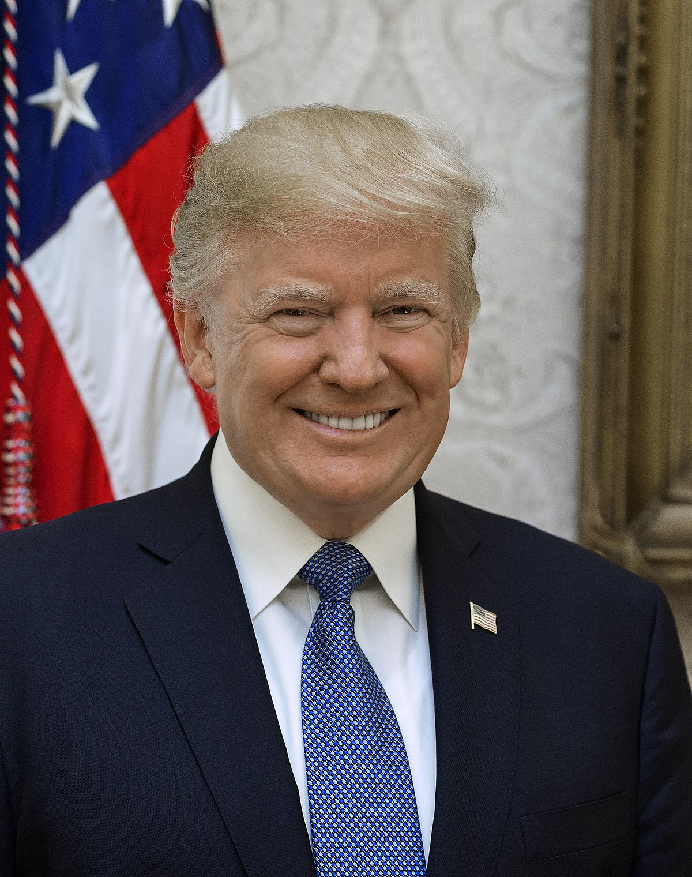
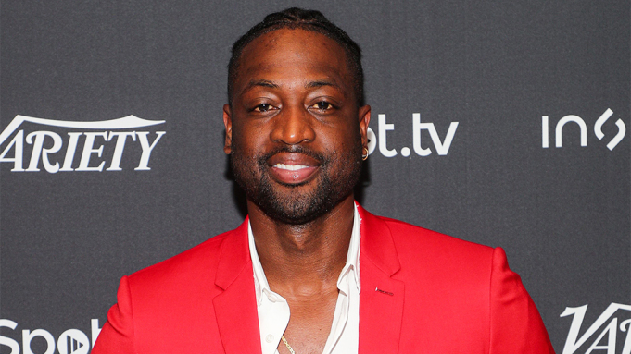
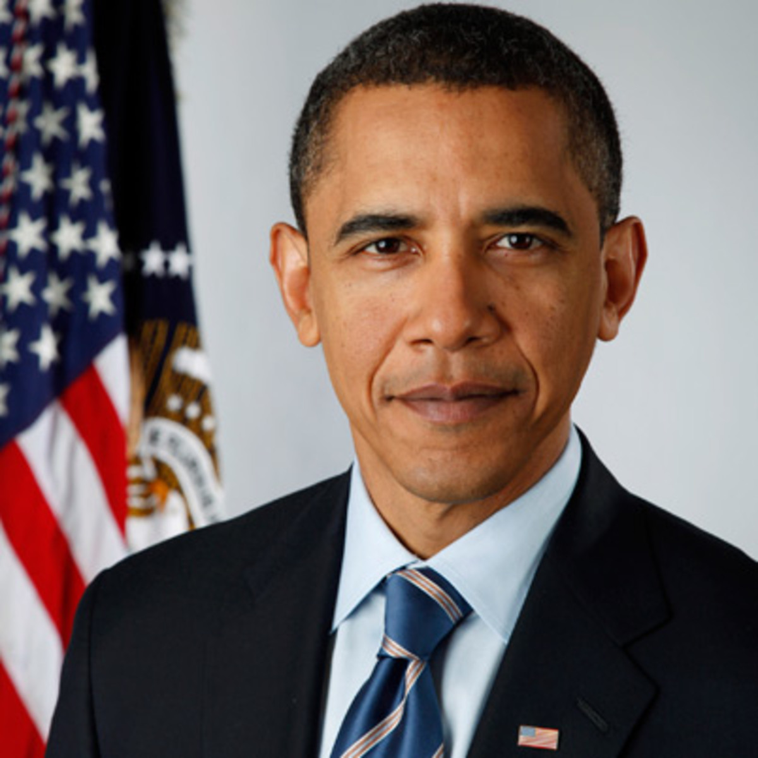

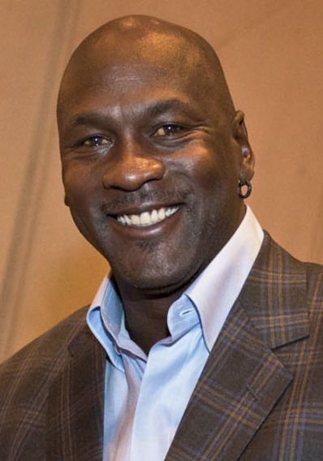

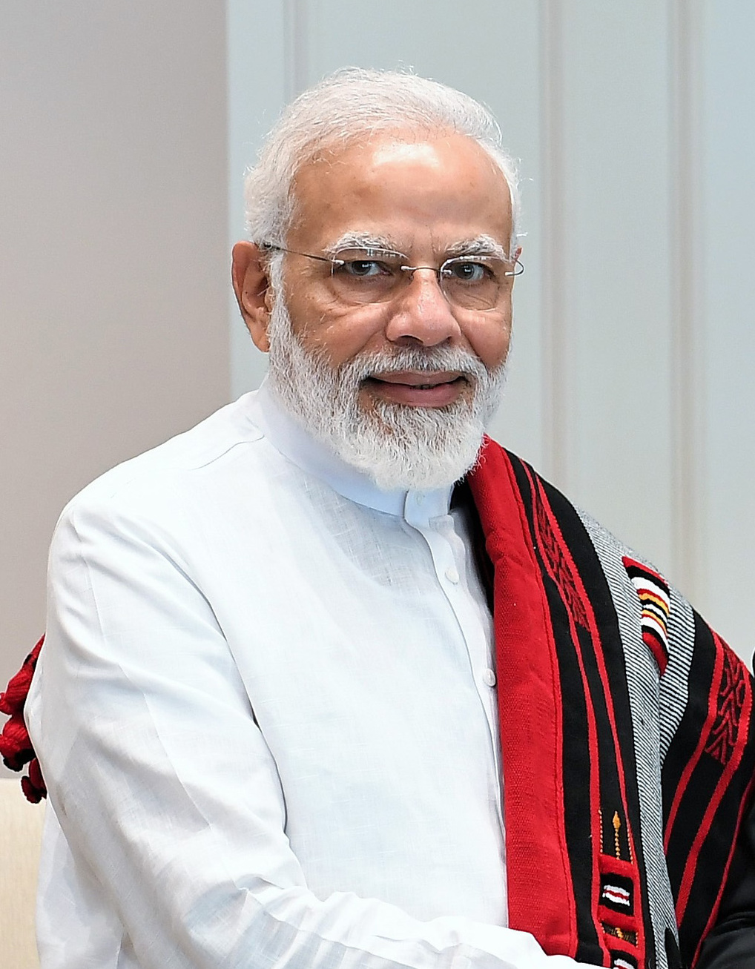
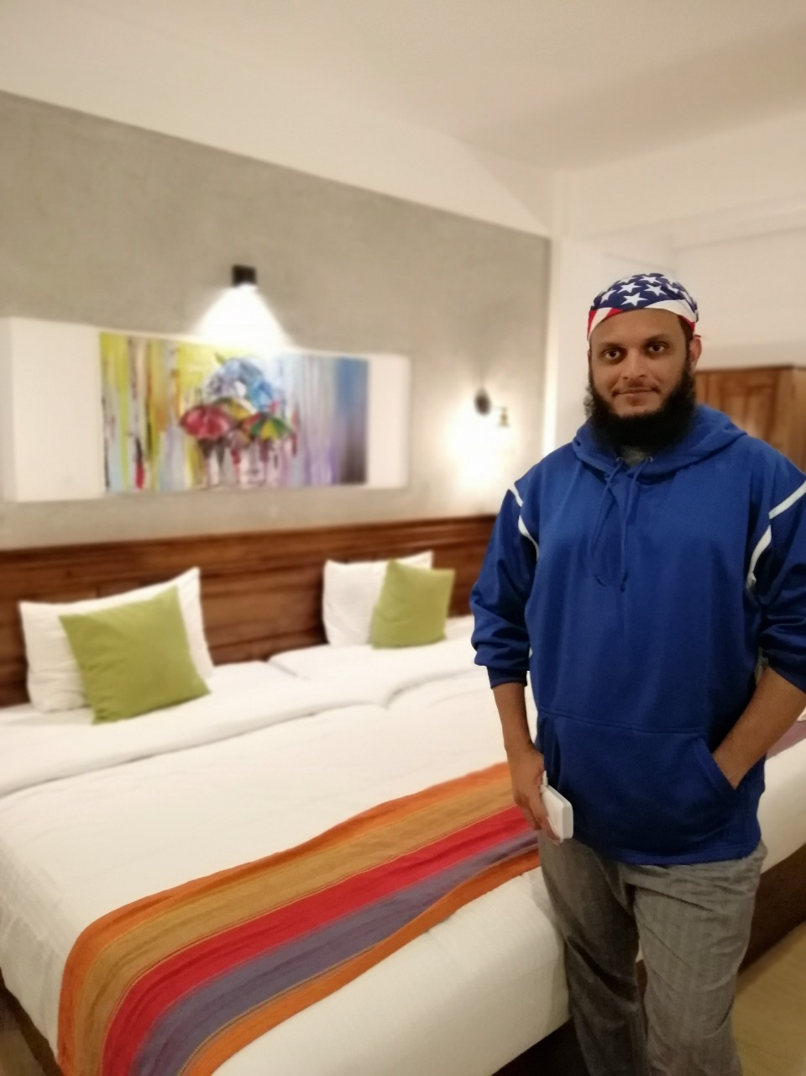
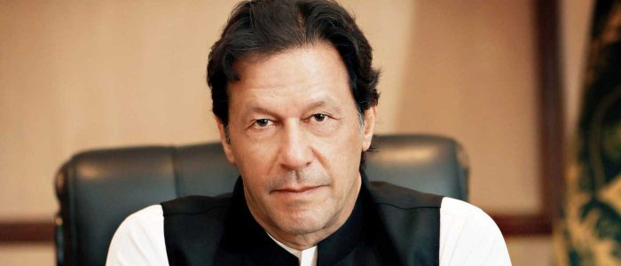
This is how we see faces

Slide 4
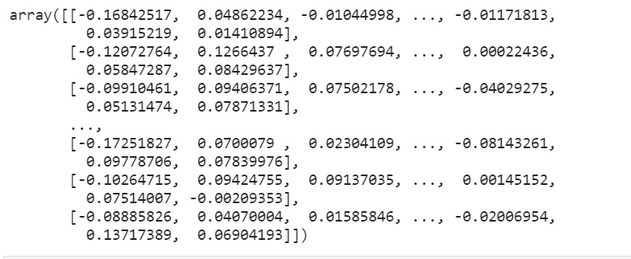
Methodology & Technology:
How we can also see our faces?

Slide 5
Work done
Ready
To
See
Our
Program execution!

Slide 6
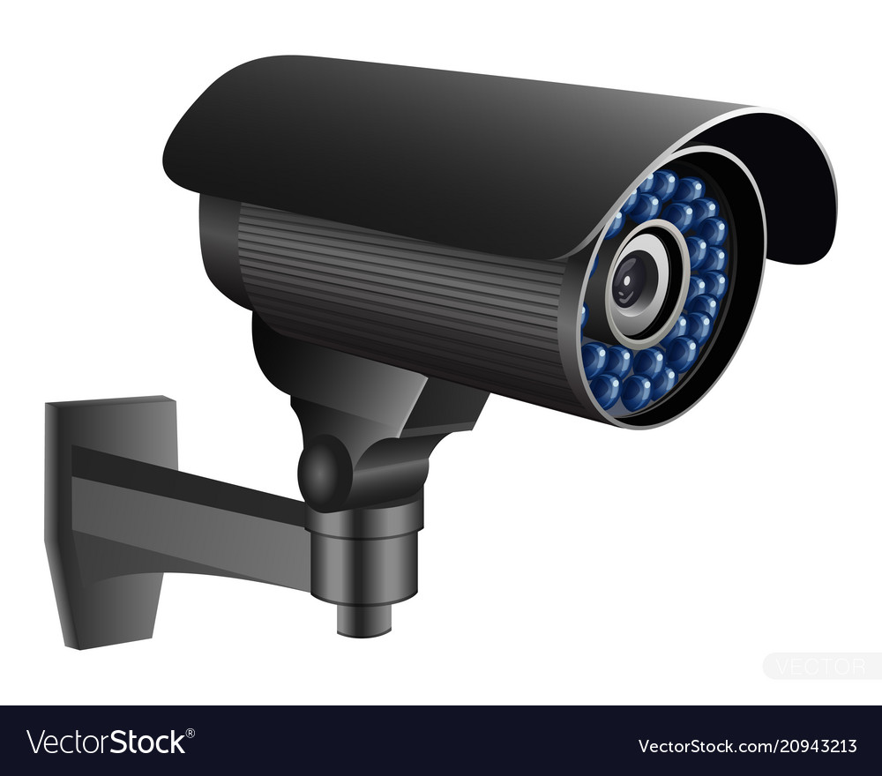
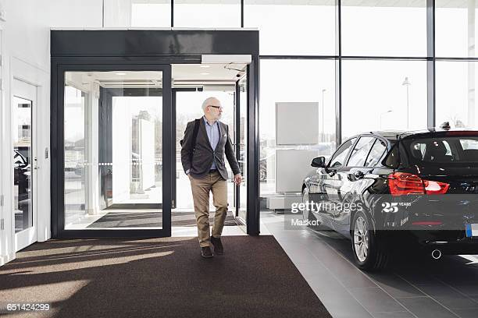

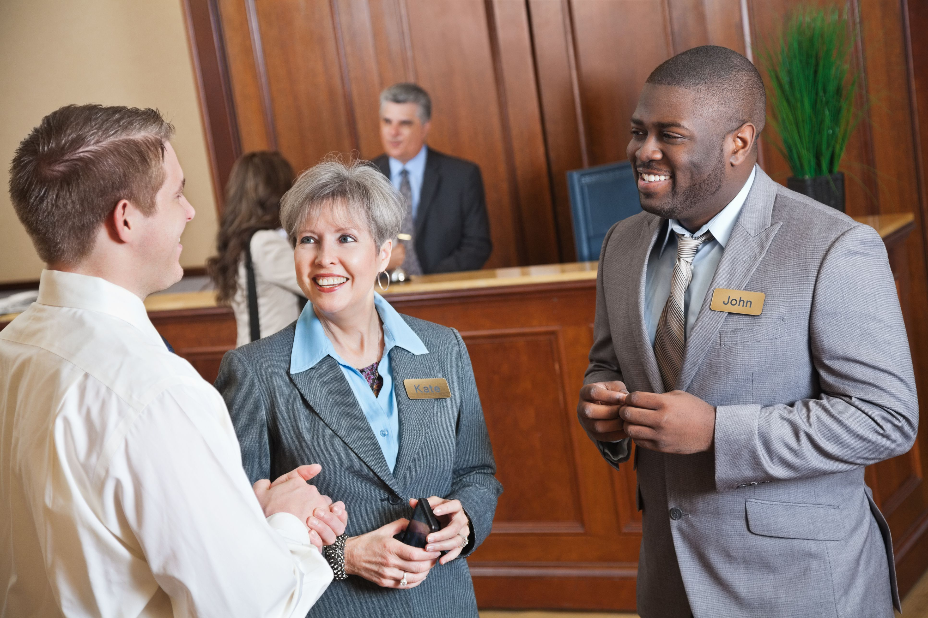
Stage 2
Sends it to Manager System
and process the program
Stage 3
Records a small clip
Stage 1
CCTV Detects the Face
Stage 5
Manager Walks to the customer and treats him special
Stage 4
Manager is notified:
“Our Premium Customer has walked in.”

Slide 7
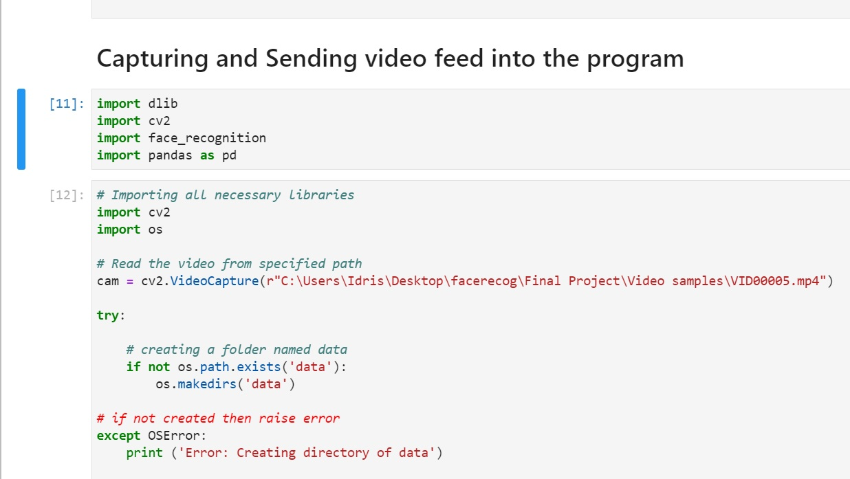
Code explained

Slide 8
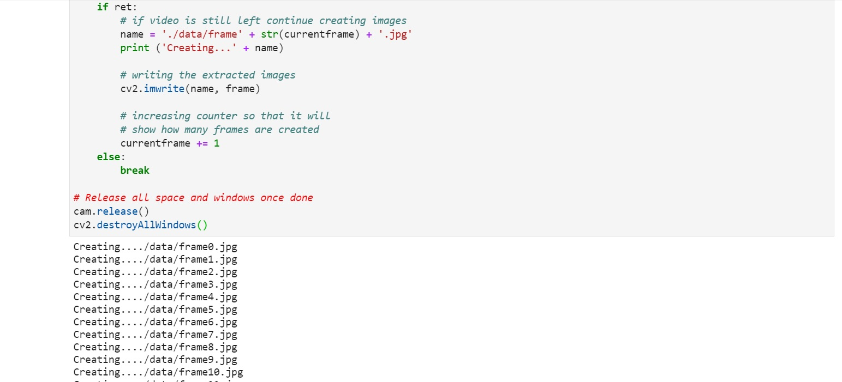
Image frames being printed

Slide 9
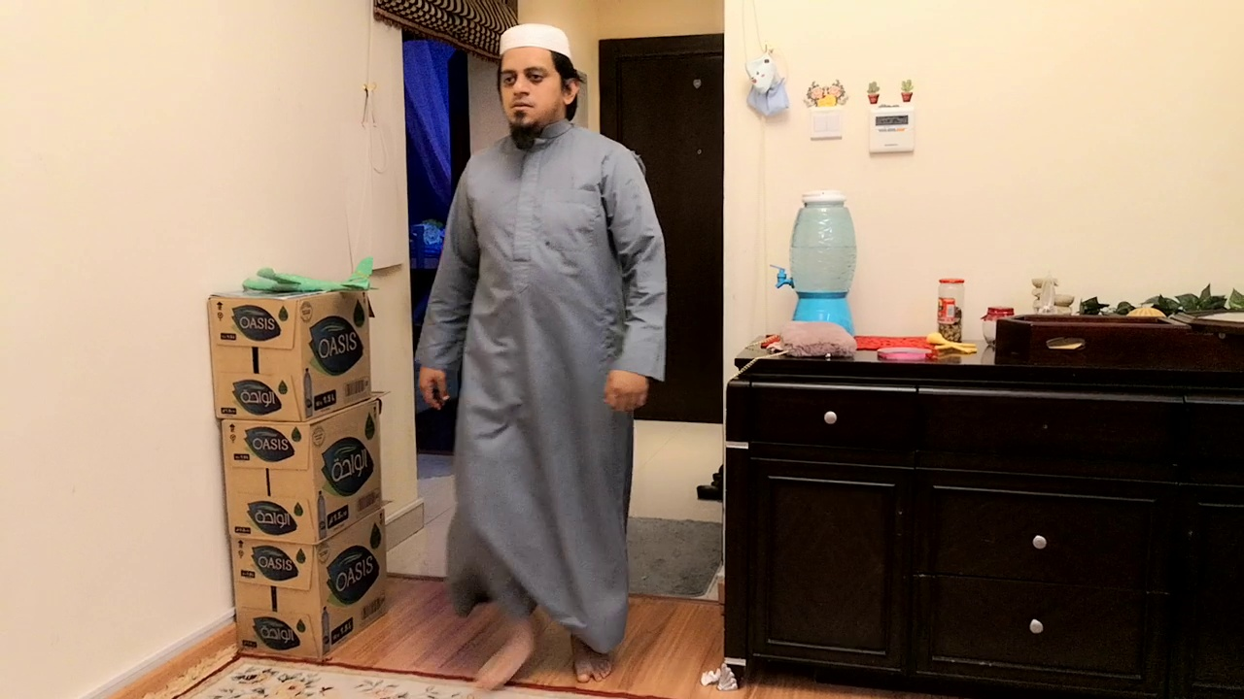
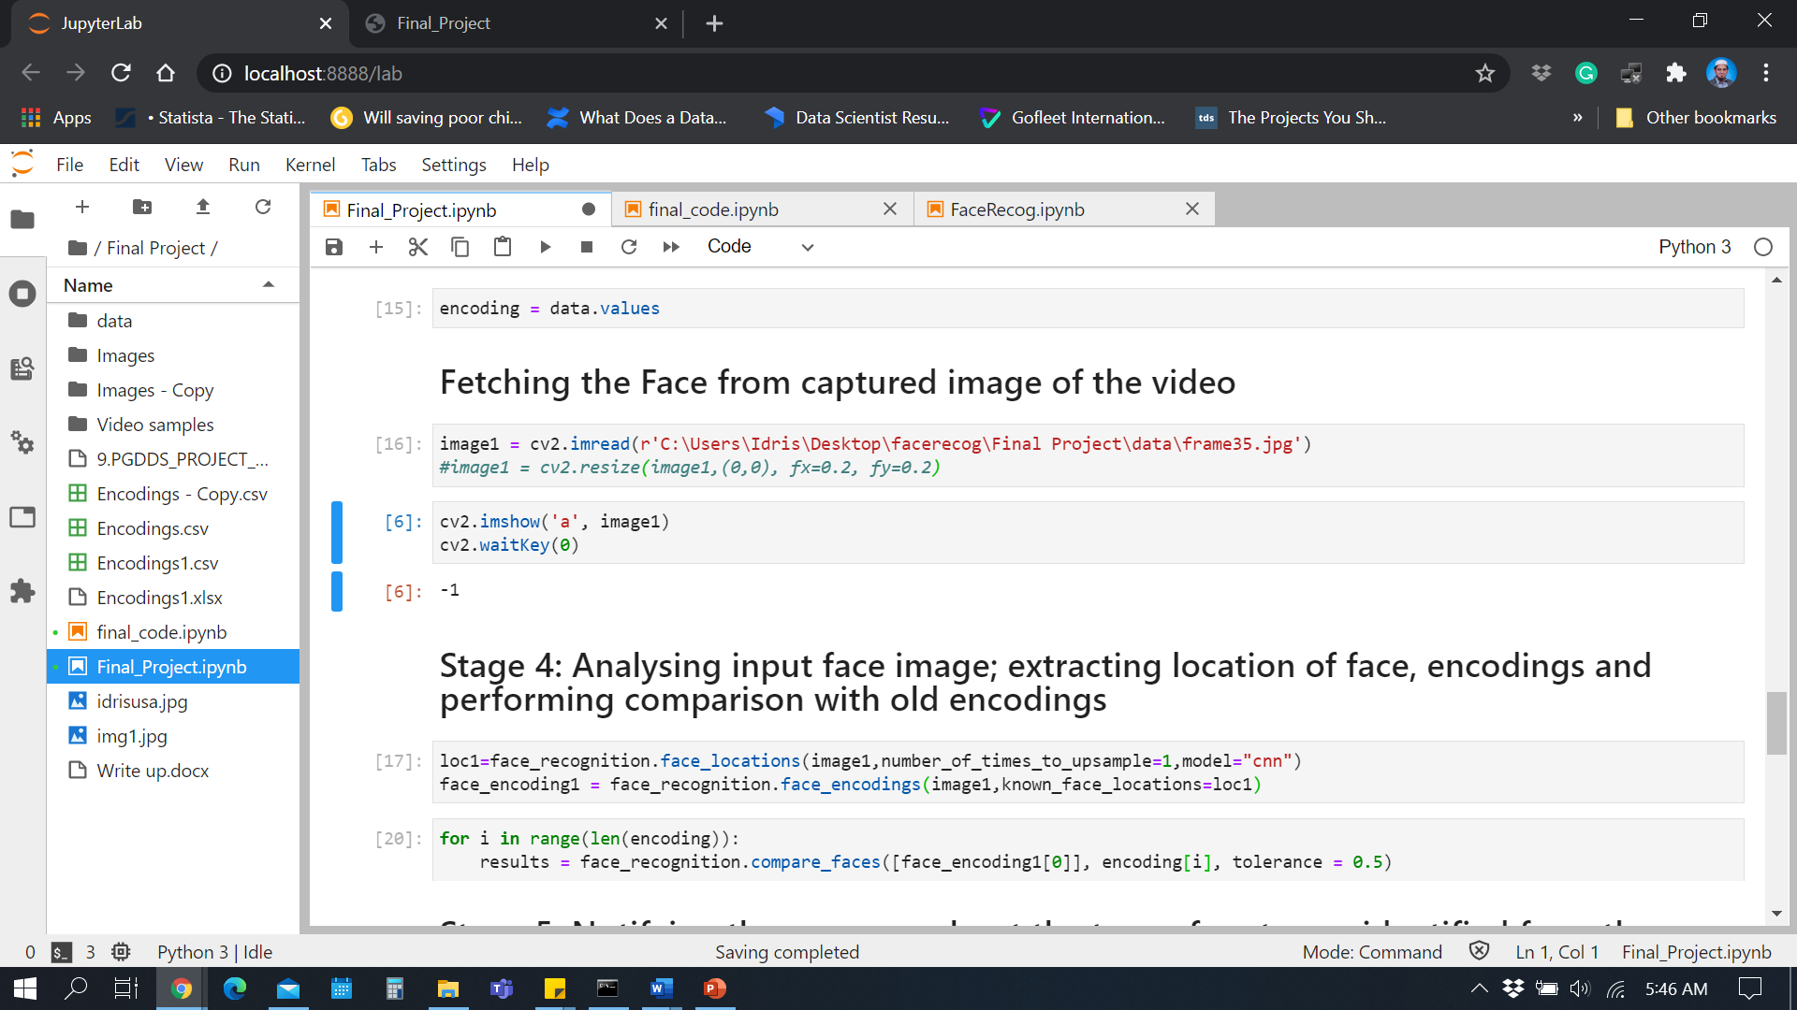
Frame 35

Slide 10
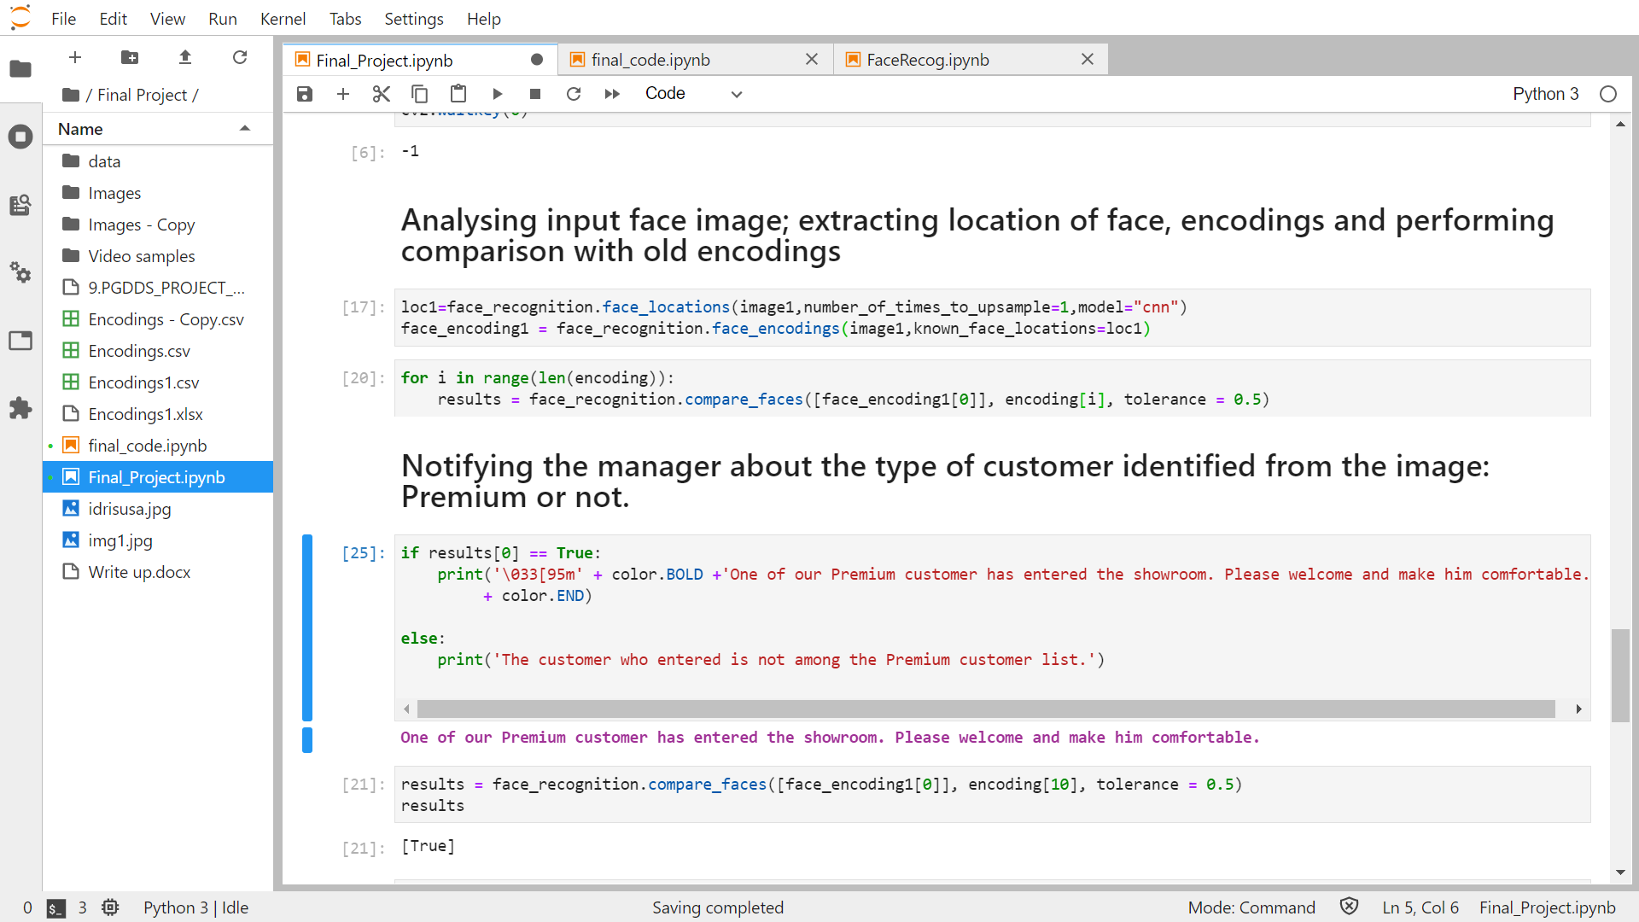

PREMIUM CUSTOMER DETECTED

Slide 11
OUTCOME

Slide 12
RESULT

Slide 13
CONCLUSION

Slide 14
THANK YOU
THANK YOU

